Slide 1
PDF-4+/Web 2023
TECHNICAL QUESTIONS TO HELP YOU DETERMINE IF PDF-4+/Web 2023 CAN RUN ON YOUR NETWORK
August 2022

Slide 2
What is Network Latency? I’m more familiar with bandwidth.
Network latency is simply defined as the time delay observed as data transmits from one point to another. Doing a latency test will determine if you want to purchase the PDF-4+/Web product. I will show you how to test for latency in the next two slides.
Latency usually occurs when you are no longer using your Internet Service Provider’s network and you get routed to another Internet Service Provider’s network. Most of the time it is transparent when using a web browser due to webpages not requiring lots of bandwidth, but you can have problems accessing information from the internet.
The other key aspect is bandwidth, with regard to the internet is generally referred to as the amount of data that can be uploaded or downloaded to or from a server. The more bandwidth, the faster files can be uploaded or downloaded depending on your total network traffic.

Slide 3
Examining Network Latency – Reliable Connection
Click on Start, then Run (or use the keyboard shortcut by pressing the Windows Key and the letter r) type cmd, and then click OK. Once you get to a command prompt dialog window, type tracert 198.139.133.139. In my example, I picked a random IP Address. What to look for:
Look at milliseconds (ms), are these numbers over 100 ms in more than 3 - 5 rows? This tracert example shows a good reliable connection and you can consider the purchase of PDF-4+/Web since the example numbers are less than 100 ms.
Note: “ms” is a thousandth of a second. A tracert is a computer network diagnostic tool for displaying the route (path) and measuring transit delays of packets across an Internet Protocol (IP) network.
Good, fast and reliable connection

Slide 4
Examining Network Latency – Unreliable Connection
Click on Start, then Run (or use the keyboard shortcut by pressing the Windows Key + letter r) and type cmd, then click OK. Once you get to a command prompt dialog window, type tracert 198.139.133.139. In my example, I picked a random IP Address. What to look for:
Look at “ms”, are these numbers over 100 ms in more than 3 - 5 rows? This tracert shows a bad connection. In this case we recommend the purchase of PDF-4+ on CD or DVD.
Notice the amount of times you switch ISPs.
Bad, slow and unreliable connection

Slide 5
Why do we need to open Internet Ports?
PDF-4+/Web provides the needed portability for accessing the PDF-4+ database via the INTERNET. It enables full functionality of the PDF-4+ database using a high-speed INTERNET connection. For more information about PDF-4+/Web click: https://www.icdd.com/pdf-4-web/ _{or https://webpdf4.icdd.com}
Internet ports allow INTERNET applications to communicate with one another over the INTERNET. For example, your web browser uses port 80 to communicate based on http:// in the URL or port 443 based on https://.
Firewalls are the best way to open or close INTERNET ports. There are twotypes of Firewalls: software and hardware. Firewalls are used to monitor, route (allow), or restrict communication between INTERNET applications. They can be found in operating systems like Windows®, in routers, and as stand-alone appliances. Home users have little, if any restrictions. Business and government institutions usually have more restrictions and will likely require changes to the firewall. If there are no restrictions, these ports are not blocked by your firewall.
You may need to explain the PDF-4+/Web ports to your I.T. Manager so these ports can be opened.

Slide 6
Why do we need to open Internet Ports?
The PDF-4+/Web 2023 uses two ports: 222220 and 3331. The server name is https://webpdf4.icdd.com.
The ICDD communicator is an INTERNET application used to validate your software license. It also verifies that you only have one instance of the PDF-4+/Web running at a time. Once you are verified, it will display your license on your screen and you will be able to use the PDF-4+/Web 2023. The PDF-4+/Web 2023 ICDD communicator uses port 22220.
The ICDD Communicator enables access to the PDF-4+/Web when the USB dongle is connected. Stopping the ICDD Communicator or removing the USB dongle will disable your access to the database.
The ICDD database also uses another INTERNET port. This allows you to retrieve information from our database. The PDF-4+/Web 2023 database uses port 3331. Most business and government users will need to consult their I.T. departments and provide the following to facilitate opening of ports:
Server = http://webpdf4.icdd.com or IP Address 198.139.133.139 & TCP/IP Ports=22220 and 3331.
More information is located at http://webpdf4.icdd.com/2023/files/WebPDF42023ReadMe.pdf

Slide 7
How can I tell if my TCP/IP ports are open?
Download the port query utility from Microsoft®
http://www.microsoft.com/en-us/download/details.aspx?displaylang=en&id=24009
Run the downloaded file and follow the on-screen directions. Make a note of where the utility is placed.
Find and run portqryui.exe – the default location is C:\PortQryUI\.
Enter “webpdf4.icdd.com” or 198.139.133.139 for the destination.
Select “Manually Input Query Ports”.
Enter “22220, 3331” for the ports.
Open ports will show as "LISTENING". Any other response means the ports are not open.
If the ports are not open, contact your I.T. department. Your I.T. department can open these ports for you.
The next slide shows you how to determine if your ports are open.

Slide 8
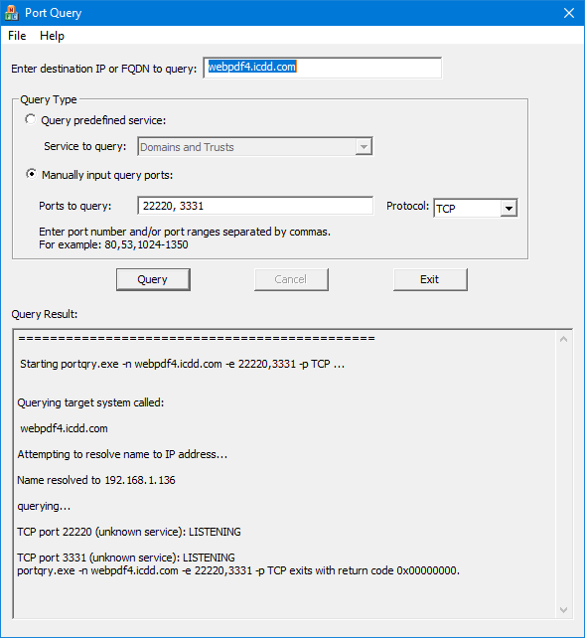
How can I tell if my computer’s TCP/IP ports are open?
Enter “webpdf4.icdd.com” or the IP of 198.139.133.139
Select “Manually input query ports”.
Enter ports “22220, 3331” Protocol = TCP
Click “Query”
Open ports will show as "LISTENING". Any
other response means the ports are not closed and you will not be able to access the database.

Slide 9
Tips with Vendor Software
If you are using vendor software, you would likely build binary files. In this case, make sure you are on a “wired connection”. Also, make sure the network adapter does not go into power saving mode by unchecking “Allow the computer to turn off this device to save power” in the “Device Manager”. You may need your I.T. Department to set this option.
If your vendor’s software does not work with the current PDF-4+/Web 2023, you will still need to install and register the PDF-4+/Web 2023. This will allow you to use the PDF-4+/ Web 2022 product by extending last year’s product by one year.

Slide 10
Installing your product
If you are renewing your software subscription download it from:
http://webpdf4.icdd.com/2023/downloads/PDF-4+Web2023.exe
If you just purchased the PDF-4+/Web 2023, the installation will be located on your dongle. If you accidentally delete your installation program, you can download it from the site above.
Be sure to read the ReadMe.pdf: http://webpdf4.icdd.com/2023/files/WebPDF42023ReadMe.pdf. It explains how to install the product after the ports are opened and has a FAQ section.
If the computer you’re using requires more than one IP address the PDF-4+/Web will not work.

Slide 11
Review
If you did not observe delays in data transmission using the tracert command and you are interested in purchasing the PDF-4+/Web 2023 database, please contact the ICDD sales department at 610-325-9814 or sales@icdd.com.
If you did observe delays in your data transmission using tracert, then you may want to reconsider and purchase a USB or DVD of the PDF-4+ 2023 product. If you still want the PDF-4+/Web, it may impact access time for your search analysis.
If your ports are not opened, explain to your I.T. Department what the ports are being used for and you would like to use the PDF-4+/Web 2023.
If you have any questions or need help installing your product, please contact ICDD at 610-325-9814 or webpdf4support@icdd.com.

